Slide 1

React Hooks
Contents:
useState
useRef
useEffect
useReducer
useContext
axios

Slide 2

What are hooks?
Functions, that must be called inside of react component functions or inside of other react hooks
Rules:
Must be called inside the functional components
Must be called at the top level of component functions

Slide 3
useState
Syntax :
const [ state, setState] = useState(defaultValue)
state : will be the current data snapshot
setState : function that is used to update the state
Note : calling setState will also tell react that the component function needs to be executed again

Slide 4
Guidelines
While updating state using setState use a function instead of the state directly
✓ setState(prevValue => !prevValue)
✕ setState ( !value)
Objects and arrays are reference values in java script and hence should not be mutated directly , Instead create a deep copy first.
✓ Const newObject = […stateObject]
newObject.name =‘react’
✕ Const newObject = stateObject
stateObject.name =‘react’

Slide 5
useRef
provides an object with current value, which when updating doesn’t trigger the re-render.
Syntax:
const refValue = useRef(defaultValue)
Access the variable by:
Updated as:
refValue.current = valueToBeSet
refValue.current
always and only a ‘current’ property

Slide 6
Ref vs State
Ref:
Doesn’t re-render the components
Can be used to gain direct DOM element access.
Eg: For reading value, accessing browser API’s
State:
Causes components to re render when changed
Should be used for those values that are directly reflected in the UI
Not to be used for those states that has no direct UI impact

Slide 7

State management with UseContext and UseReducer

Slide 8
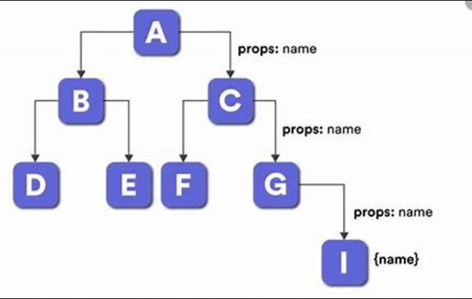
Prop Drilling
Passing shared data through multiple layers of components tree
Solutions :
Component composition ( using wrapper )
React’s context API

Slide 9

Context API
We create a context value and wrap this context value, around multiple components
The state, or the state updating function that we need to share across multiple components is now linked to the context value
The context value is provided at the root level, to wrap the children components

Slide 10
Syntax:
const ContextName = createContext(initialValue)
Note
createContext returns a value which is an object that contains a react component in an attribute
Used As:
Const context = useContext(Contextname)
Or <MyContext.Consumer>
{(context)=>}
</MyContext.Consumer/>
Provided As:
<ContextName.Provider>
<ChilCOmponnets/> <ContextName.Provider>

Slide 11
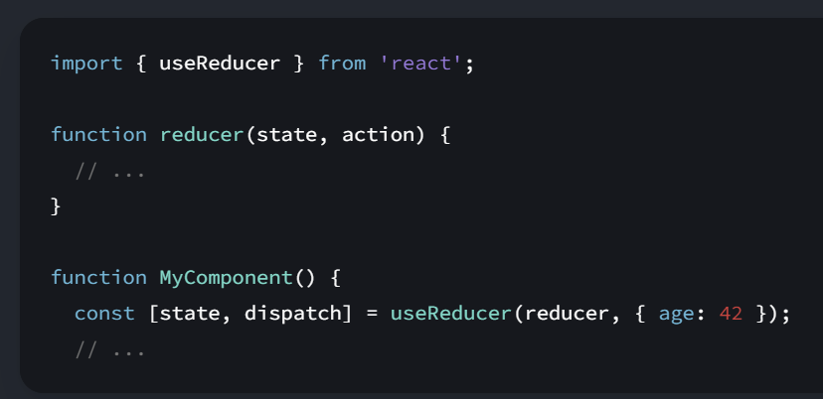
useReducer
Helps in complex state management
Syntax

Slide 12
UseEffect and Axios

Slide 13
What are side effects?
A side effect in programming refers to any operation or action that affects something outside the current function or component
In React, side effects are often operations like
Making API calls
Subscribing to external events
Updating the DOM
Setting up timers

Slide 14
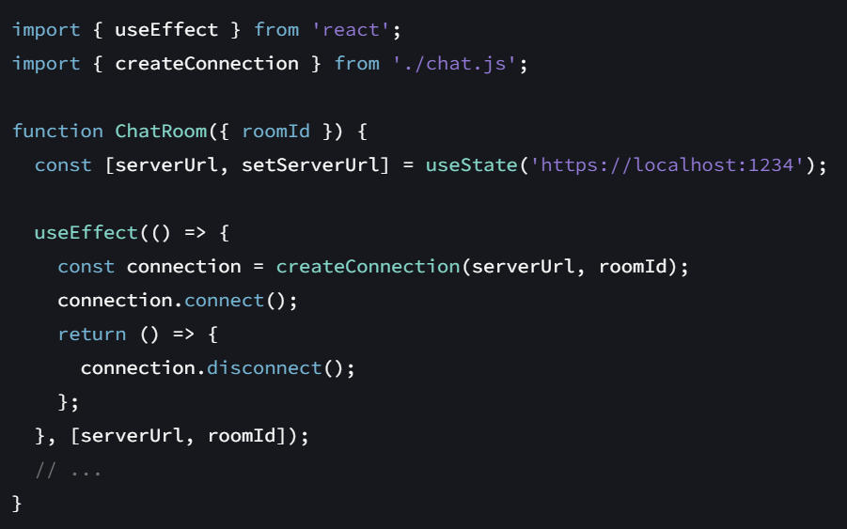
UseEffect
Syntax :
useEffect(setup, dependencies?)

Slide 15
useEffect(()=>{},[])
First argument :
The function with your Effect’s logic.
When your component is added to the DOM, React will run your setup function.
After every re-render with changed dependencies, React will first run the cleanup function (if you provided it) with the old values, and then run your setup function with the new values.
After your component is removed from the DOM, React will run your cleanup function.
Second argument :
The list of all reactive values
Reactive values include props, state, and all the variables and functions declared directly inside your component body
This function may also optionally return a cleanup function.

Slide 16

Axios
Axios is an HTTP client library based on promises. It makes sending asynchronous HTTP requests to REST endpoints.

Slide 17
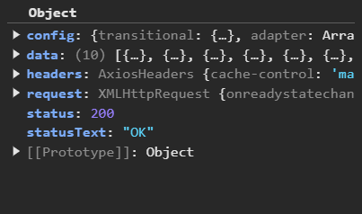
Example of axios response

